Slide 1
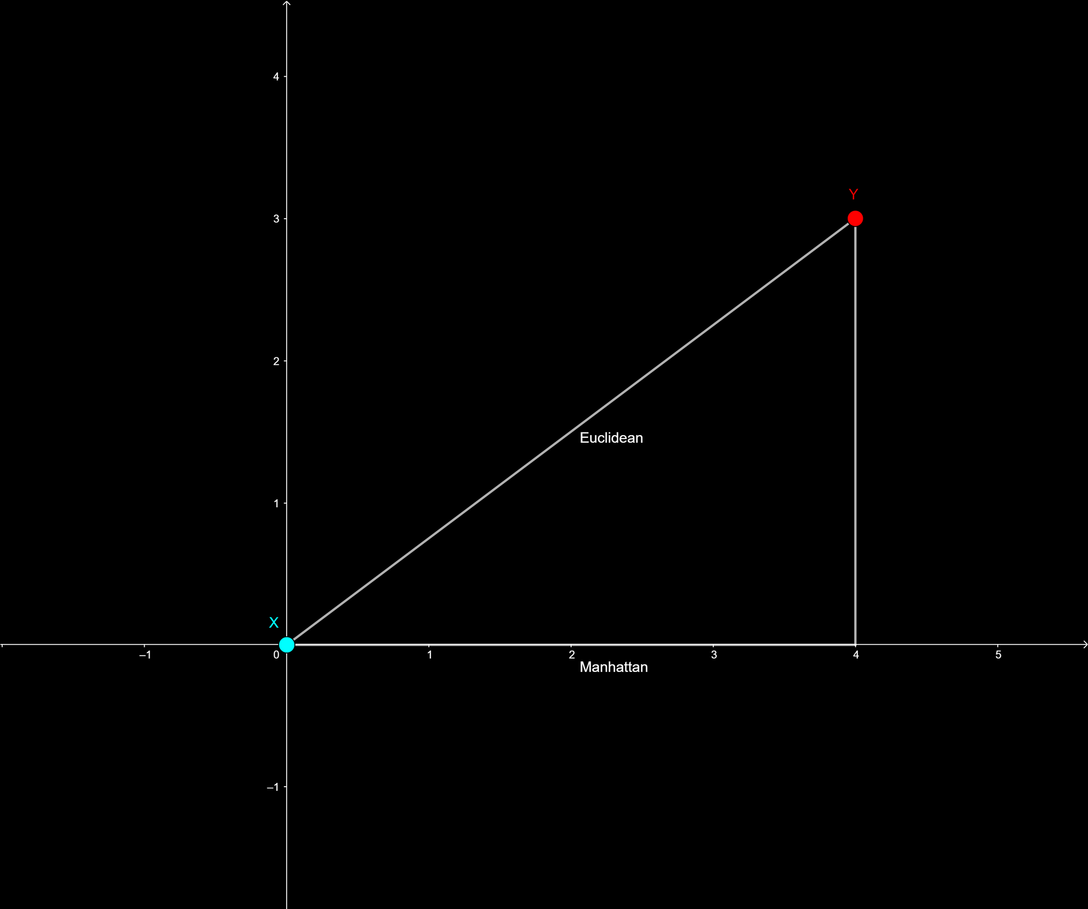
Euclidean, Manhattan and squared distances
Presented By :- SNEHAL TAWAR

Slide 2


Contents:
Introduction
Euclidean Distance
Manhattan Distance
References

Slide 3
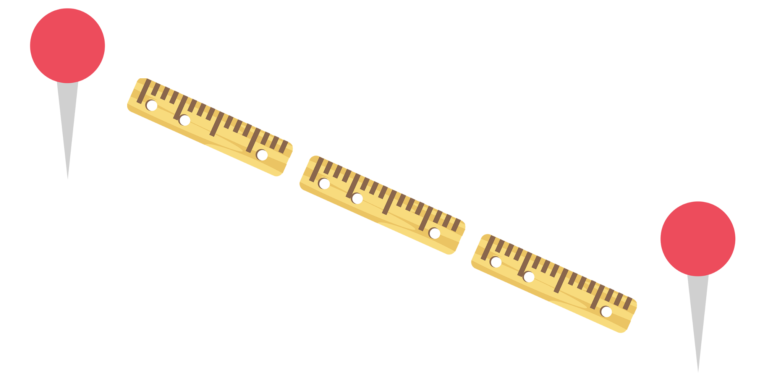
Introduction
Many Supervised and Unsupervised machine learning models such as K-NN and K-Means depend upon the distance between two data points to predict the output. Therefore, the metric we use to compute distances plays an important role in these models.
Some distance metrics used in machine learning models are:-
Minkowski distance
Manhattan distance
Euclidean distance
Hamming distance
Cosine distance

Slide 4
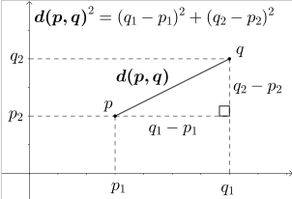
Euclidean Distance
The Euclidean distance between two points in Euclidean space is the length of a line segment between the two points. It can be calculated from the Cartesian coordinates of the points using the Pythagorean theorem, therefore occasionally being called the Pythagorean distance.
The distance between any two points on the real line is the absolute value of the numerical difference of their coordinates. Thus if p and q are two points on the real line, then the distance between them is given by:
d ( p , q ) = | p − q | .

Slide 5


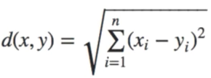
A more complicated formula, giving the same value, but generalizing more readily to higher dimensions, is:
Two dimensions
In the Euclidean plane, let point p have Cartesian coordinates ( p 1 , p 2 ) and let point q have coordinates ( q 1 , q 2 ). Then the distance between p and q is given by:
It is calculated using the Minkowski Distance formula by setting ‘p’ value to 2, thus, also known as the L2 norm distance metric. The formula is:-

Slide 6
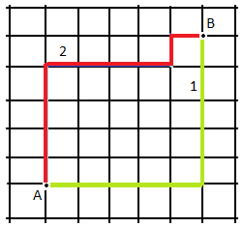
Manhattan Distance
We use Manhattan distance, also known as city block distance, or taxicab geometry if we need to calculate the distance between two data points in a grid-like path. Manhattan distance metric can be understood with the help of a simple example.
In the above picture, imagine each cell to be a building, and the grid lines to be roads. Now if I want to travel from Point A to Point B marked in the image and follow the red or the yellow path. We see that the path is not straight and there are turns. In this case, we use the Manhattan distance metric to calculate the distance walked.

Slide 7

We can get the equation for Manhattan distance by substituting p = 1 in the Minkowski distance formula. The formula is:-
When is Manhattan distance metric preferred in ML?
Manhattan Distance is preferred over the Euclidean distance metric as the dimension of the data increases. This occurs due to something known as the ‘curse of dimensionality’.
Conclusion:
Manhattan distance is usually preferred over the more common Euclidean distance when there is high dimensionality in the data. Hamming distance is used to measure the distance between categorical variables, and the Cosine distance metric is mainly used to find the amount of similarity between two data points.

Slide 8
References:
https://medium.com/@kunal_gohrani/different-types-of-distance-metrics-used-in-machine-learning-e9928c5e26c7
https://bib.dbvis.de/uploadedFiles/155.pdf
Introduction to Social Network Methods: Robert A. Hanneman, Mark Riddle, University of California, 2005
https://youtu.be/ofIfXMPem2M
https://youtu.be/p3HbBlcXDTE

Slide 9
THANK YOU !

